Slide 1



WEATHER SERVICE WORKSHOP 2
BY => HARSAHBAJ SINGH
STUDENT ID => 146457221
SECTION => ZAA
Group => 2

Slide 2

An app to simplify the process of advising the city service clerks regarding what action is needed in a specific weather condition.

Slide 3


The basic structure of when what action is to be will already be loaded and saved in the application.

Slide 4
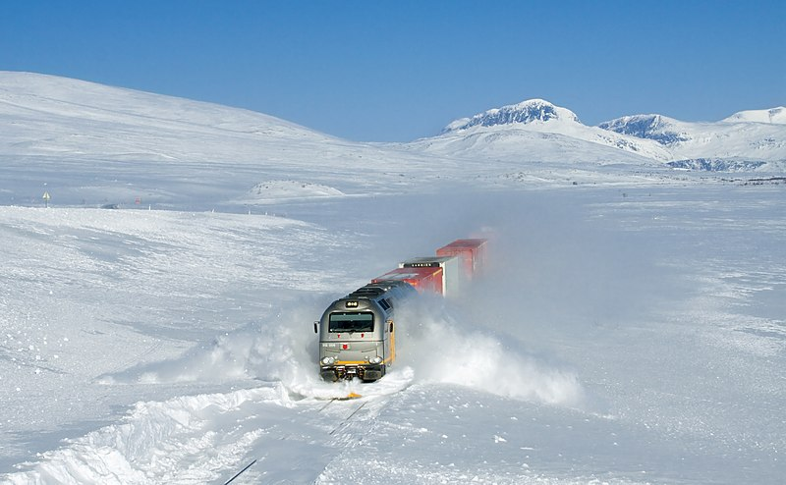



THE REQUIRED INPUTS
TEMPEATURE
Type of weather
Precipitation accumulation
SNOW
Measured in cm
MIXED
ICE
Measured in mm
Input for temperature is in degree celsius by default.
Depending on the type of weather the metric system for precipitation accumulation is set.

Slide 5
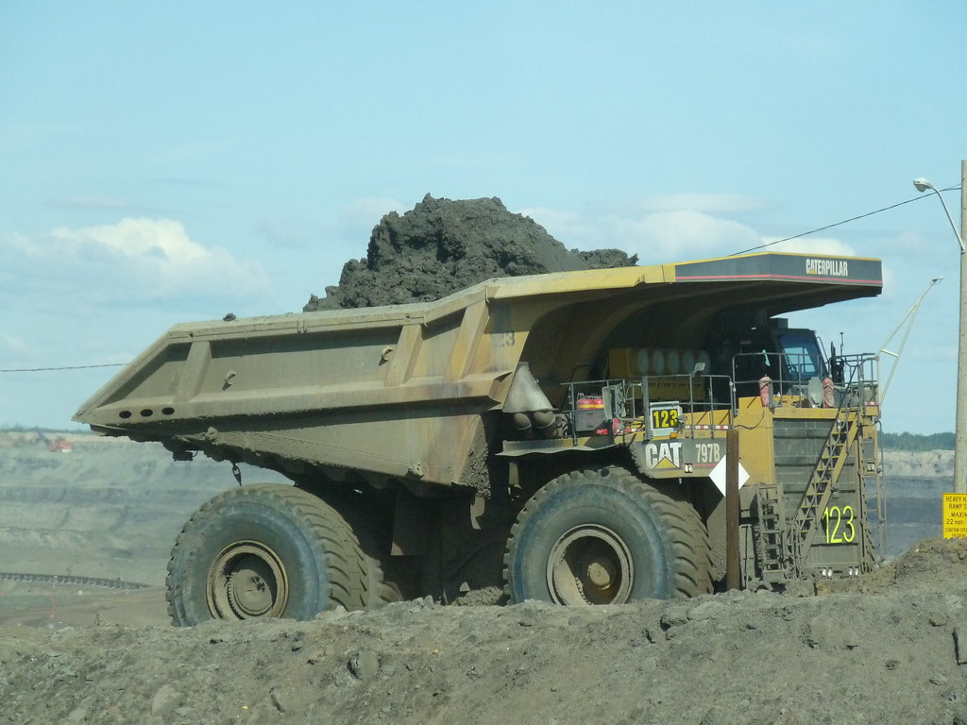
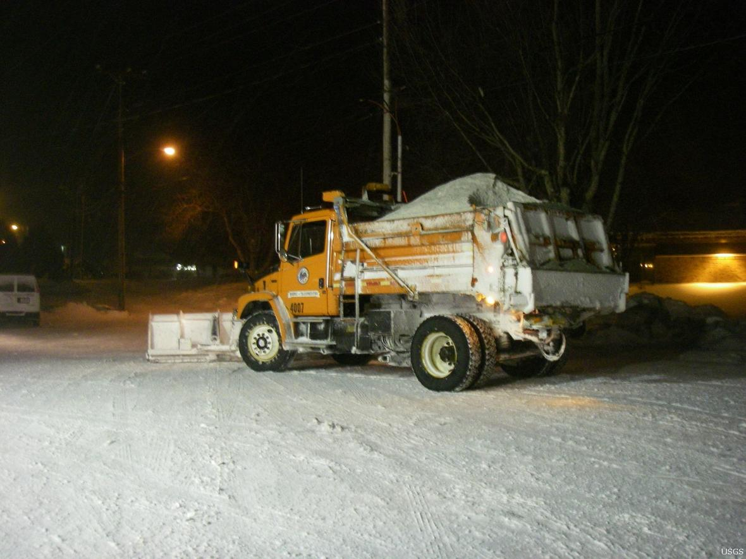
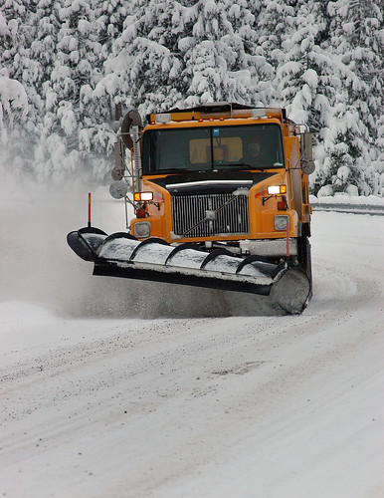
RESOURCES THAT COULD BE SENT OUT
1)SAND TRUCK
TYPE = (LIGHT,HEAVY OR NORMAL)
2)SALT TRUCK
TYPE = (LIGHT,HEAVY OR NORMAL)
3)PLOW TRUCK

Slide 6
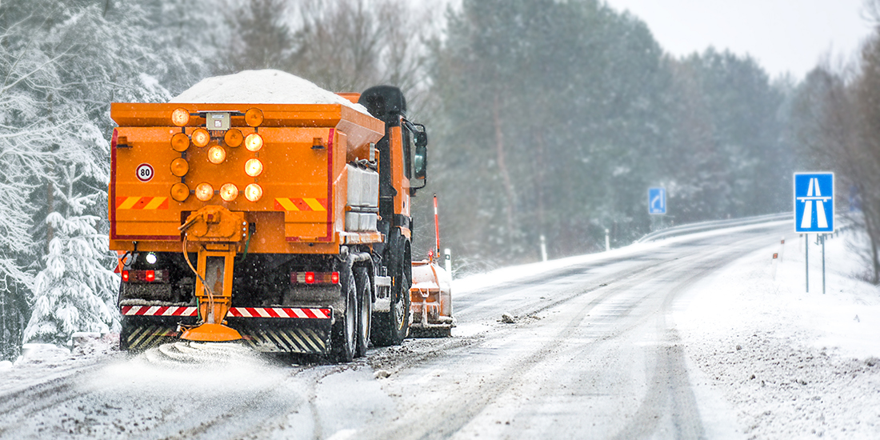
HOW WILL THIS APPLICATION WORK
TAKING INPUTS IN THE FORM OF :
TYPE OF WEATHER
SNOW
ICE
MIXED
2. AMOUNT OF PRECIPITATION ACCUMULATION
3. TEMPERATURE

Slide 7
PRINTING OUT THE OUTPUT
THERE ARE 3 POSSIBLE SCENARIOS FOR THE OUTPUT
NO ACTION IS REQUIRED.
a) NUMBER OF PLOW TRUCKS
b) NUMBER OF SALT TRUCKS AND (TYPE)
c) NUMBER OF SAND TRUCKS AND (TYPE)
3. STATE OF EMERGENCY (ORGANIZE ARMY AND OTHER JURISDICTION SUPPORT).

Slide 8

WHY THIS APPLICATION COULD BE DEEMED THE BEST POSSIBLE ONE
PROVIDES A STRAIGHT FORWARD SOLUTION TO AN OTHERWISE LENGTHY PROBLEM.
COULD BE EASILY USED BY ANYONE EVEN IF THEY ARE NOT GIVEN ANY PRIOR INSTRUCTIONS ABOUT IT.
IT HAVE A SIMPLE AND CLEAN APPLICATION MEANING LITTLE TO ZERO MARGINS FOR ERROR.

